Slide 1
Travel Expenses Tracker
PROJECT BY
Pratik P. Kapdi (233731013)
Swagat R. Doke (233731007)

Slide 2
Introduction
Project Objective:- Develop a software tool for tracking travel expenses.
User Base:- Targeted towards individuals who travel frequently and businesses managing employee travel expenses.
Tracker Complexity:- Can be simple or complex based on user needs.
Basic Features:- Typically records date, amount, and expense category.
Reporting Functionality-: Allows users to generate reports for understanding spending habits and identifying potential savings.
Decision Support:- Empowers users to make informed decisions about future travel plans based on expense reports.
Compliance Improvement:- Aids businesses in enforcing travel policies by facilitating easy expense submission, approval, and tracking.
Versatility:- Valuable tool for both individuals and businesses, providing insights into spending habits and promoting financial efficiency.

Slide 3
Features Of A Travel Expenses Tracker
Add Expenses:
Record date, amount, and category of each expense. Specify purpose, vendor, and receipt details for comprehensive tracking. Differentiate between business, family, and group expenses.
Add Trips:
Input trip details, including destination and duration. Categorize trips based on business, family, or group travel. Link expenses to specific trips for organized tracking.
Generate Reports:
Analyze spending habits for each trip type (business, family, group)..Filter reports by date range, category, or specific trips. Visualize data for a quick overview of expenses.
Print Reports:
Easily print detailed reports for record-keeping. Access hard copies for expense reimbursement or tax purposes. Provide tangible documentation for business or personal use.
Traveling Tips:
Access a curated section for valuable traveling tips. Receive recommendations based on the purpose of the trip. Enhance user experience with useful insights.

Slide 4
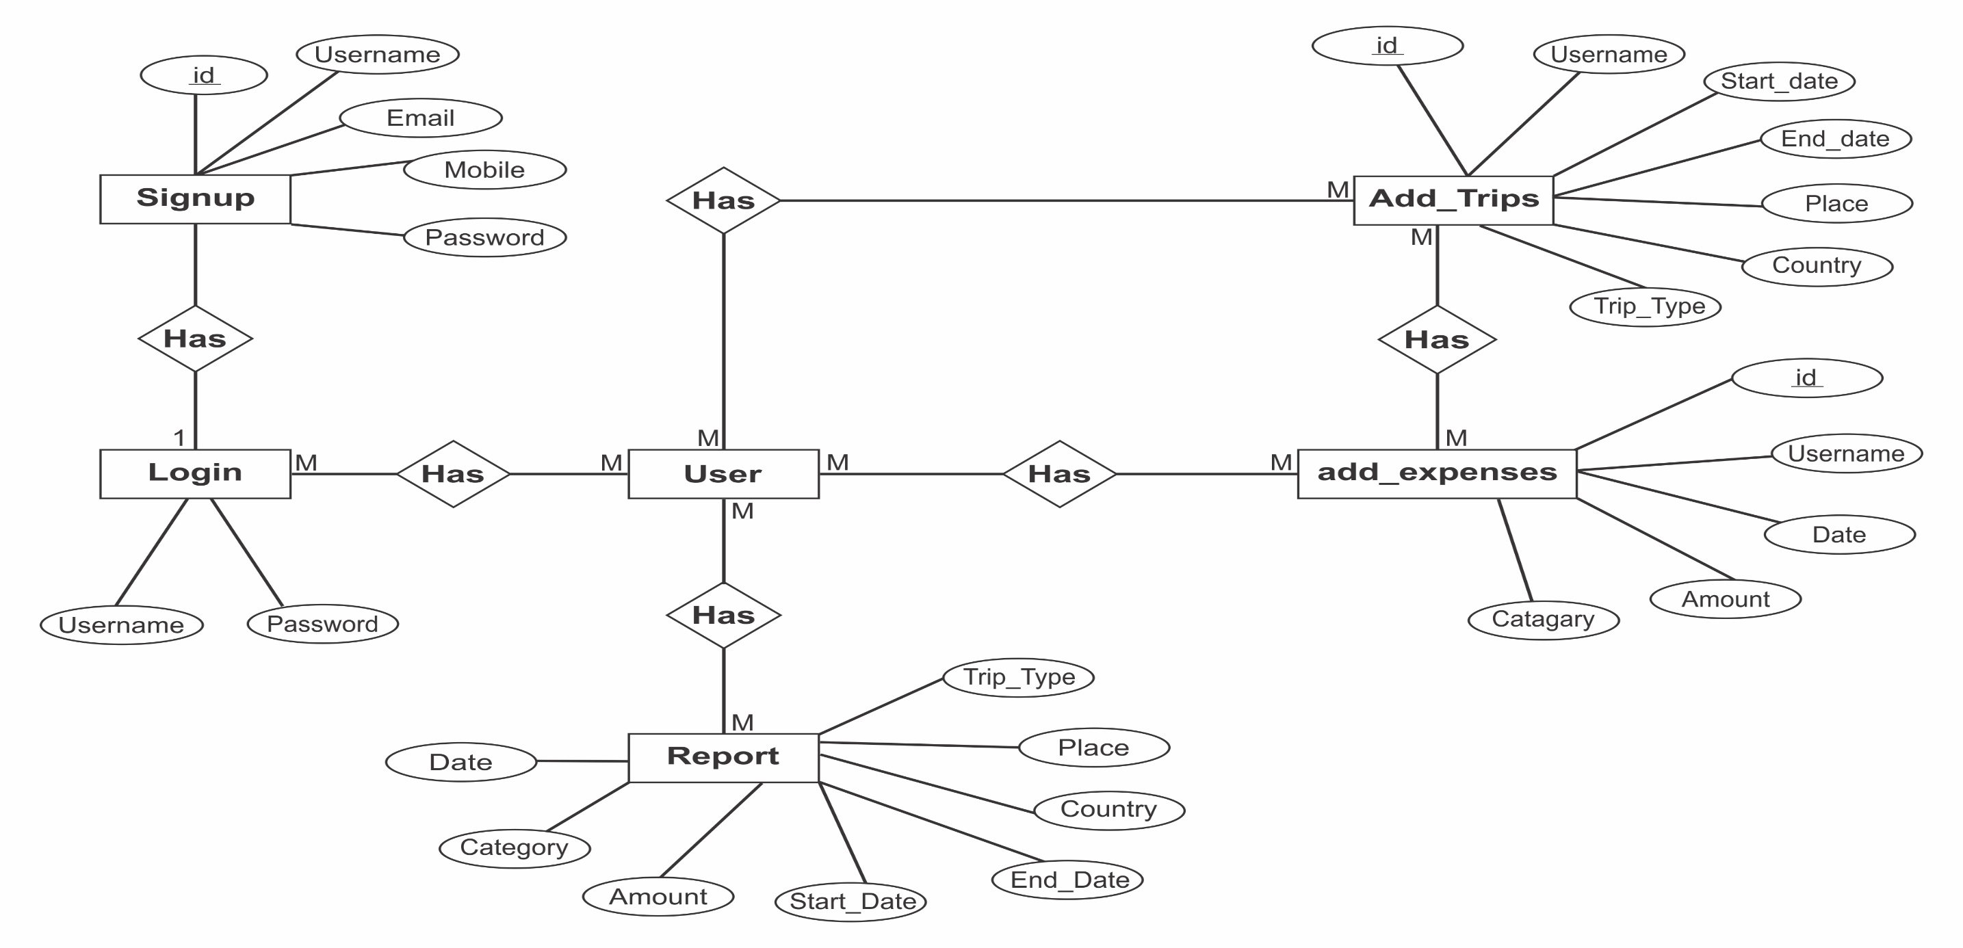
Entity Relationship Diagram

Slide 5
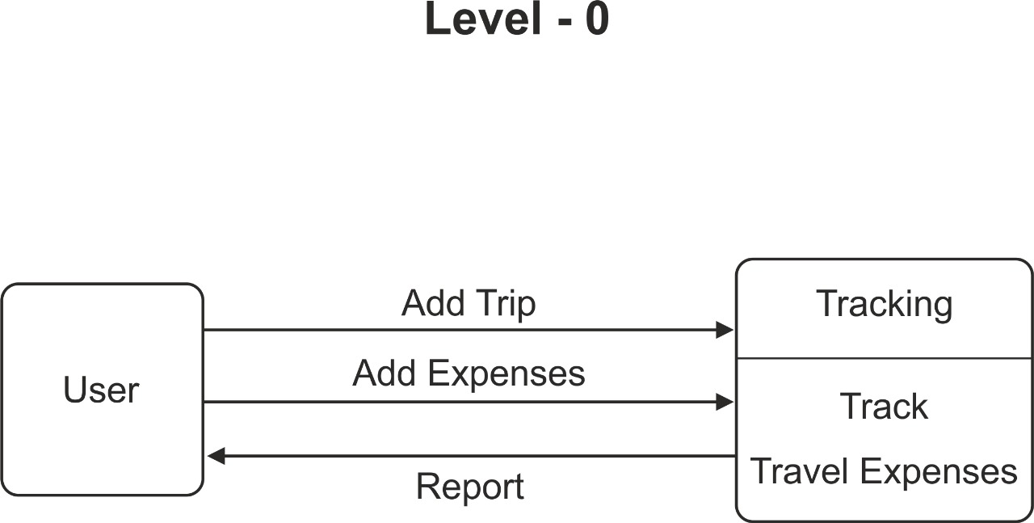
Data Flow Diagram Level 0

Slide 6
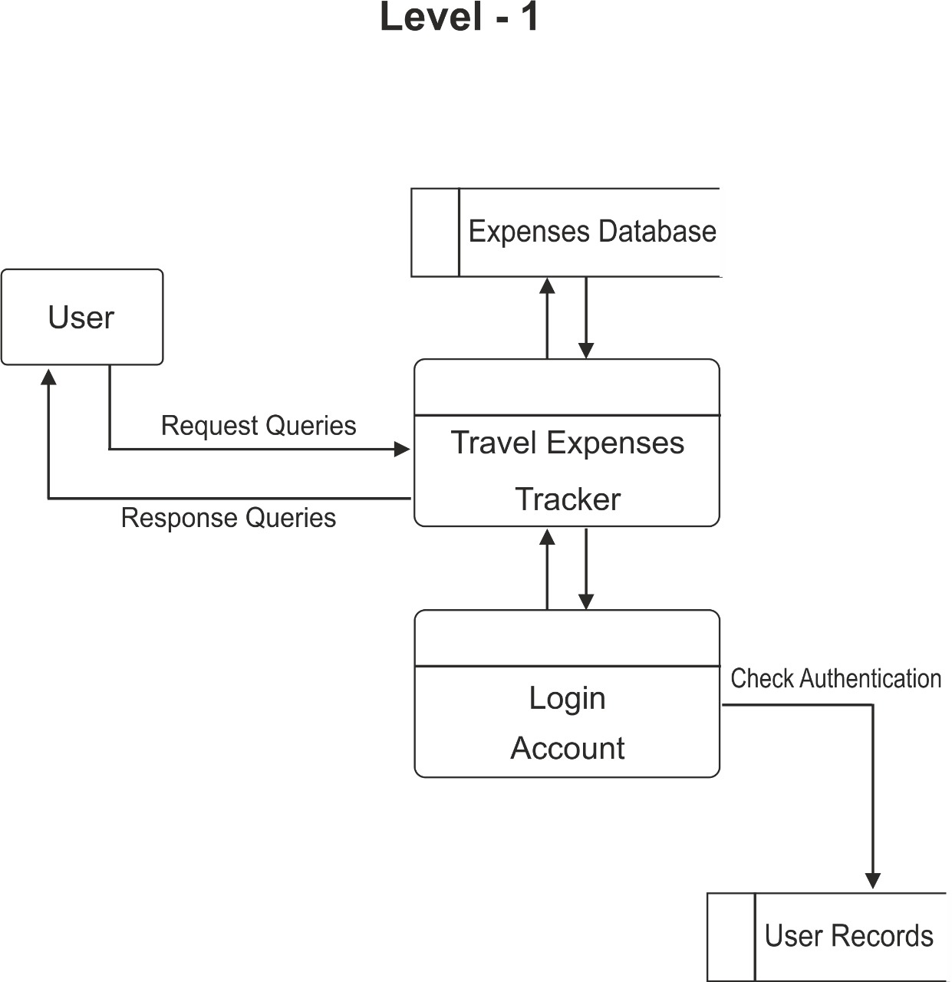
Data Flow Diagram Level 1

Slide 7
How To Choose A Travel Expenses Tracker
Data accuracy: It is essential that the system is able to accurately track all travel expenses, in order to provide businesses with a reliable overview of their spending.
Ease of use: The system should be easy to use for both employees and managers, in order to encourage adoption and ensure that all expenses are recorded accurately and on time.
Flexibility: The system should be flexible enough to accommodate different types of travel expenses and business policies.
Security: The system must be secure enough to protect sensitive financial data from unauthorized access.
Develop a detailed user guide: The user guide should provide clear instructions on how to use the system to record and submit travel expenses. It should also include information on how to approve and reimburse expenses.
Collect feedback from users: This feedback can be used to improve the system's usability and functionality.

Slide 8
Conclusion
A travel expenses tracker streamlines travel expense management, reducing paperwork, improving accuracy, and increasing visibility. By enforcing expense policies and automating calculations, it saves time and money for both employees and employers. With its ease of use, integration capabilities, and affordable pricing, a travel expenses tracker is a valuable tool for any organization.

Slide 9
Thank You
Thank you for your time. I hope this presentation was helpful.

